Slide 1


NEXT GEN EMPLOYABILITY PROGRAM
CREATING A FUTURE-READY WORKFORCE
Student Name :
Aakash Netada
College Name :
Student ID :
D.Y.PATIL Technical Campus, Faculty of Engineering & Faculty of Management
STU65bf78cf1c41d1707047119

Slide 2
CAPSTONE PROJECT SHOWCASE
Project Title
P3 News Aggregator using Django Framework
Abstract | Problem Statement | Project Overview | Proposed Solution | Technology Used | Modelling & Results | Conclusion | Q&A

Slide 3

Abstract
1
Use the HTML, CSS, and Bootstrap templates to design and create a beautiful and responsive home page
2
Establish communication between the front-end and back-end components of the web application. Use Django’s powerful template engine to dynamically display content based on user interactions and database queries.
3
Use of web scraping from the onoion.com for fetching of news & storing in the database.
4
Social sharing functionalities, including Facebook, WhatsApp, and Telegram sharing options for news articles.

Slide 4


Problem Statement
Use and implement a Django framework that enables businesses to efficiently manage digital media websites, stay abreast of breaking news, industry developments, and competitor activity The application should provide access to news and information which come from a variety in systematic sources Features such as taxonomy, user access controls for news conferences, and user-designed dashboards can be provided

Slide 5

Project Overview
News Aggregator Web Application uses Django capabilities and web scraping techniques to aggregate news stories from TheOnion.com, providing users with an easy way to access information Through a front-end interface that easily installed with HTML, CSS, Bootstrap lets users effortlessly navigate through latest content, by categories or dates Filter content, get detailed previews Django's system. Dynamic content rendering ensures users receive up-to-date news combined with easy backend data. In addition, the app includes social sharing functionality, allowing users to spread interesting news through Facebook, WhatsApp and Telegram Moreover, Content sharing and distribution is encouraged.

Slide 6
Proposed Solution
Set up a backend: Use a news API to fetch news articles from different sources.​
Create a frontend: Use HTML, CSS, and JavaScript to display the articles in a user-friendly layout
Use web crawling and parsing techniques: Extract news articles from predefined sources, such as major news outlets, online publications, blogs, or other trusted platforms.
Analyze a large body of text: Bring about country-dependent focal points based on word frequencies, repetitions, and natural emphasis in the written language.
Visualize the findings: Visualize the findings in a sophisticated and explanatory way.

Slide 7
Technology used
Django Framework
HTML, CSS and Bootstrap
Beautiful Soup
Social media APIs
Database Management using sqlite3

Slide 8
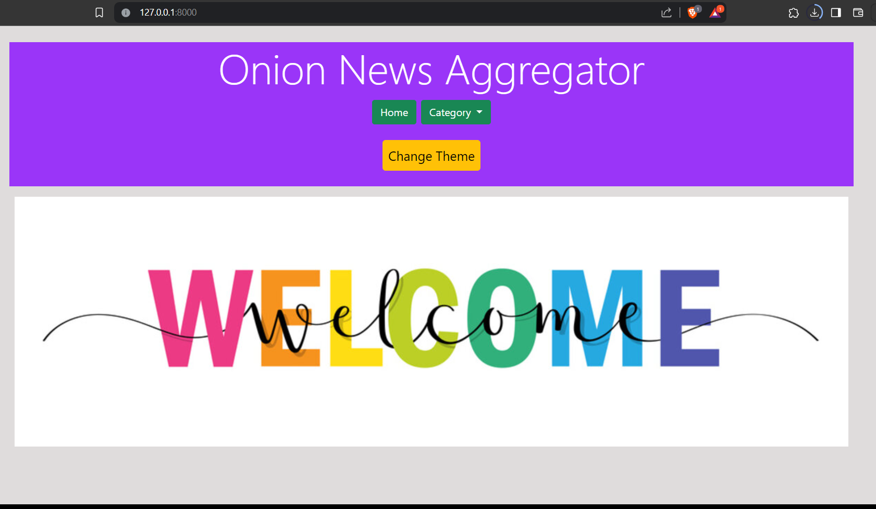
Modelling & Result

Slide 9
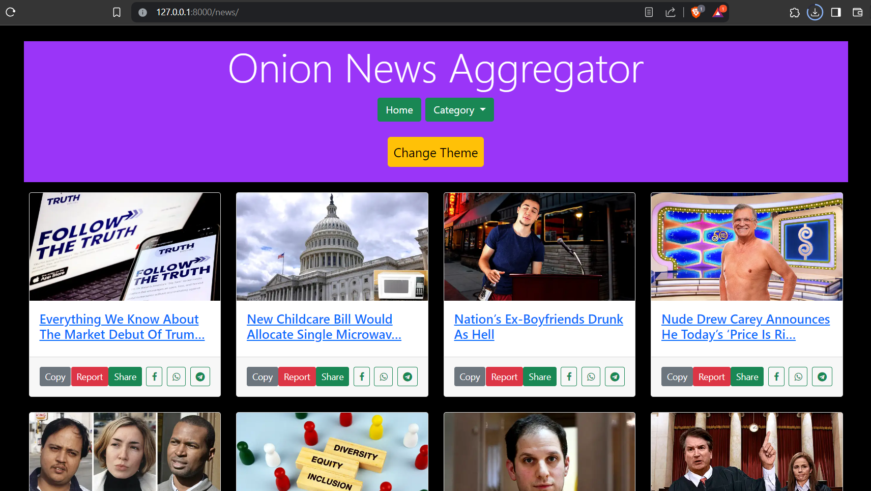
Modelling & Result

Slide 10
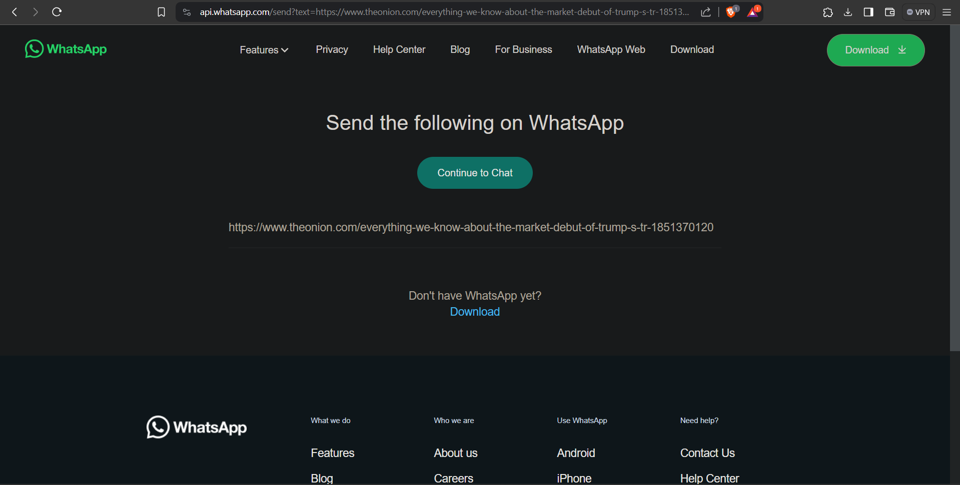
Modelling & Result

Slide 11

Conclusion
The News Aggregator Web Application uses a mixture of Django frameworks, web scraping techniques, and frontend technologies to provide users with a centralized location where they can access and access news from TheOnion.com a with its intuitive user interface, social sharing integration, and user authentication, Through personalized features such as saved-accounts functionality, the application seeks to provide an easy and enjoyable news browsing experience Leveraging these technologies effectively the project is aimed at providing users with an easy and efficient way to stay abreast of the latest media developments and encourage maximum user engagement and satisfaction.

Slide 12


Notes:
Thank You !!

